Slide 1

Software Engineering Team Project

Slide 2

Team Lead: Andrew McKissick
Devin Ritter, Tellon Smith, Johann Redhead, Anderson Nwammadi

Slide 3
Overview
Team Organization
Our Project
Our Project Focus
Known Issues
Demonstration

Slide 4
Team Organization Transformation
Team Management
Mostly agile
Began working as a group
No volunteer = assigned task
Over Time…
Team members worked individually
Group reviews

Slide 5
What is Our Project? Card Services: Wells Fargo
Customer
Dr. Terry Griffin, Assistant Professor at Midwestern State University
System design
Inherited existing design
User -> interface interaction
Interface -> database interaction
Untouchable file generation

Slide 6
What is Project Focus? Card Services: Wells Fargo
Description of problems
Poorly designed user interface
Missing essential functionality
Unsecure hashing algorithm
Goals
Redesign user interface
Enhance user productivity
Add security features

Slide 7
Known Issues Minor and Fixable
Impeding Functionality?
None
Potential Issues
Formatting errors
File generation

Slide 8
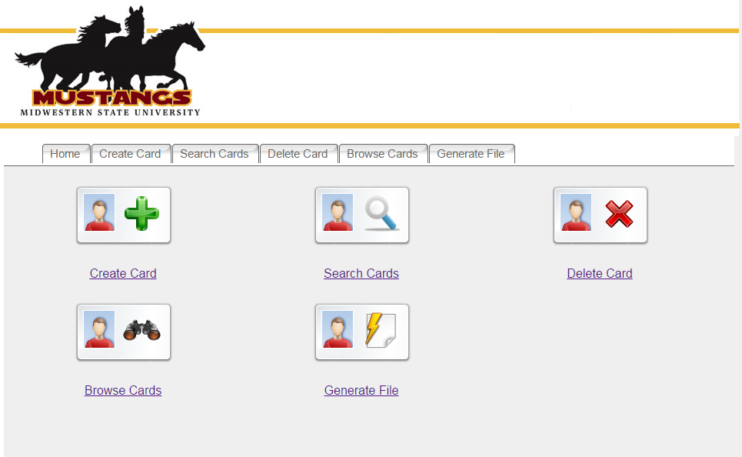
Previous Home Page

Slide 9
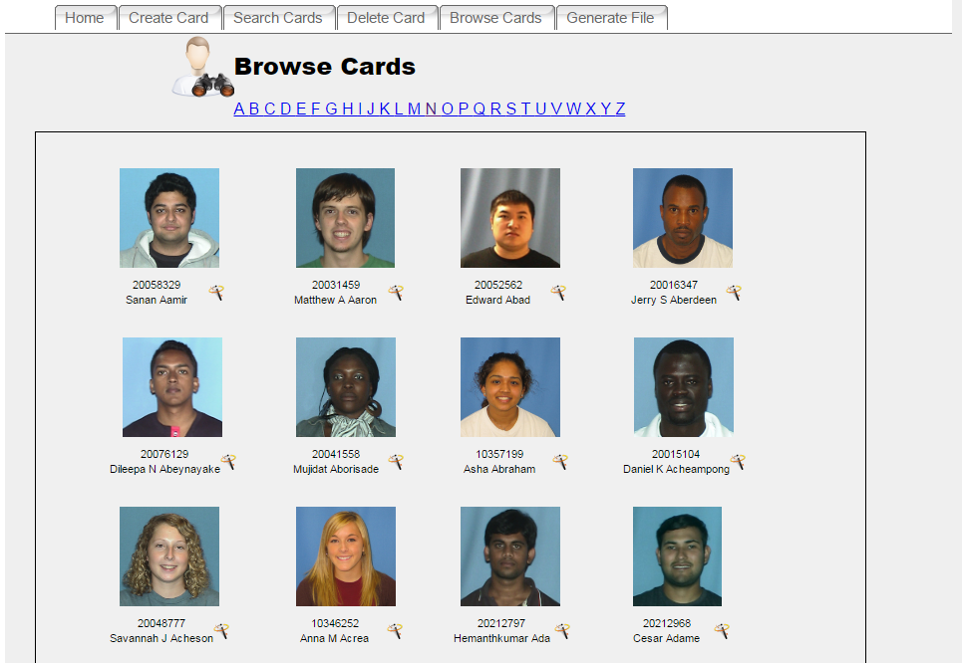
Previous Browse Cards Page

Slide 10
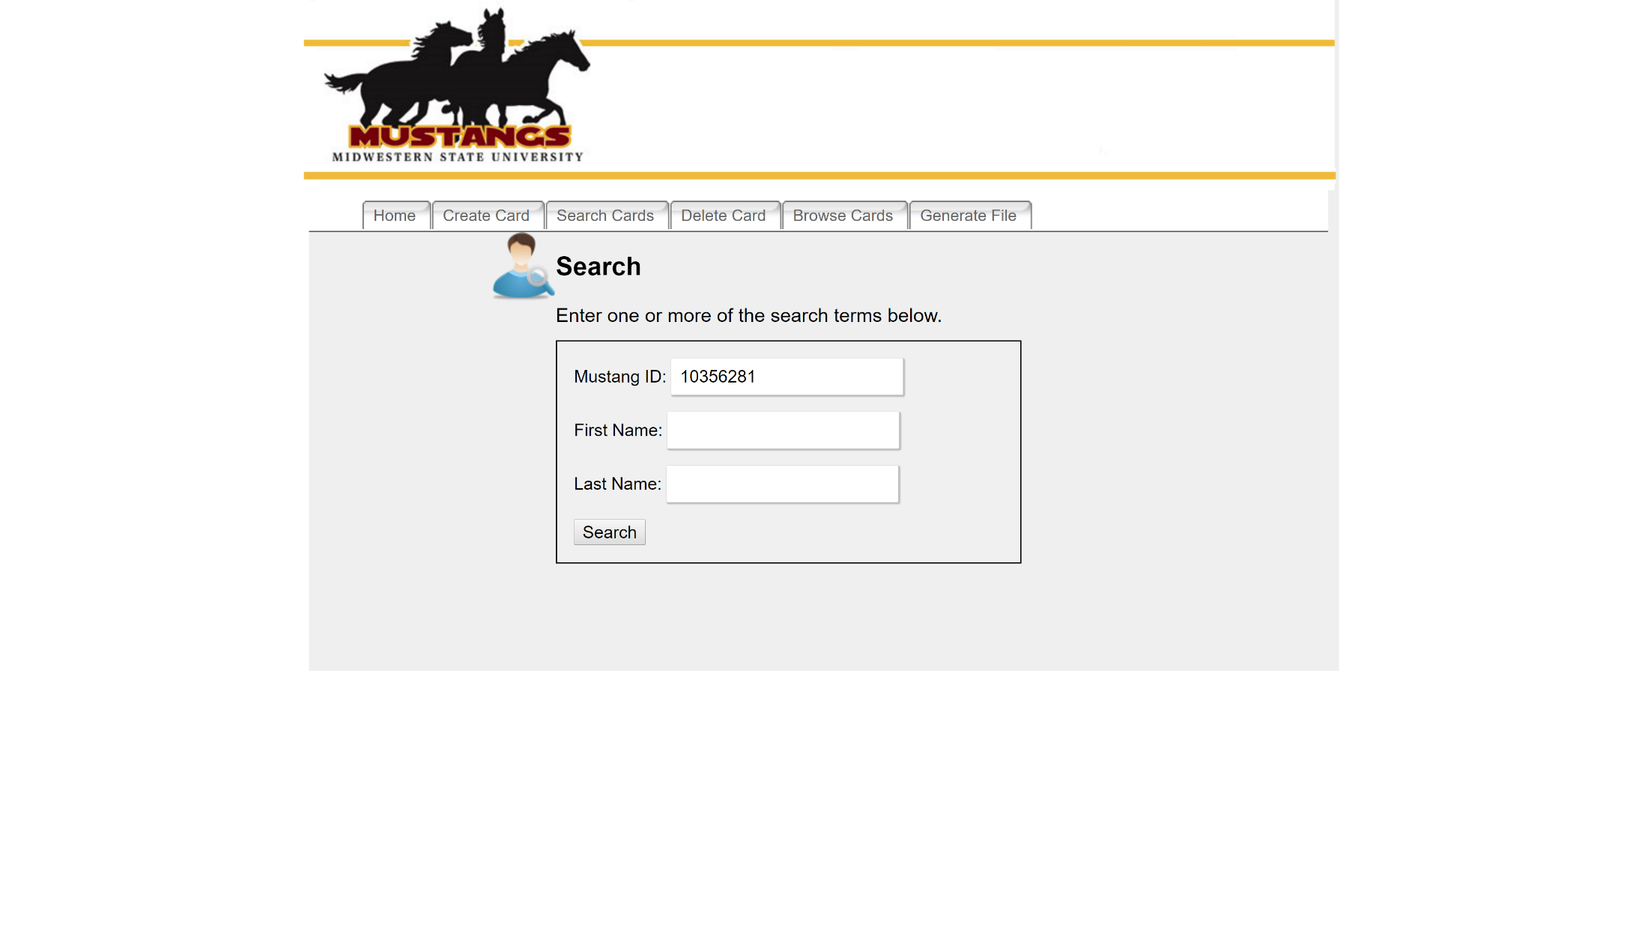
Previous Search Cards Page

Slide 11
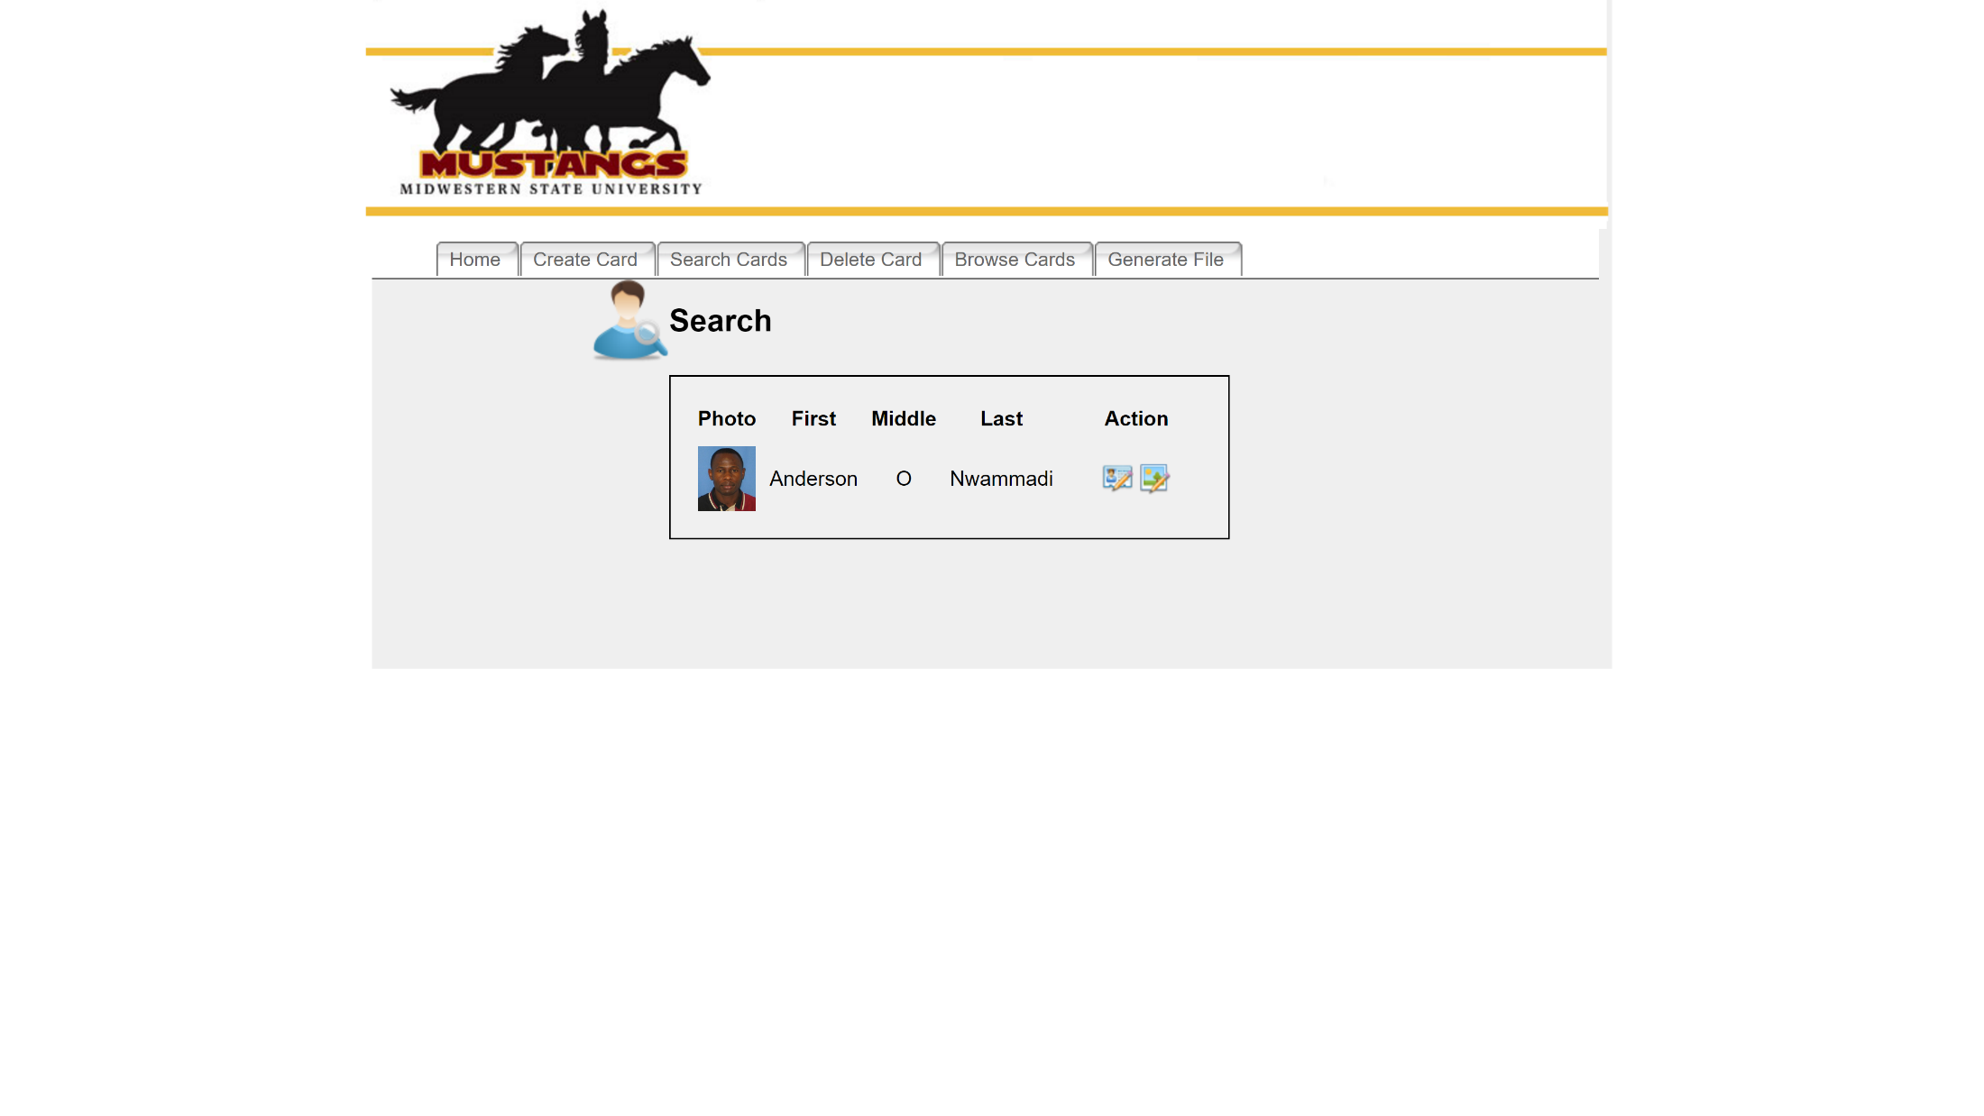
Previous Search Cards Page

Slide 12
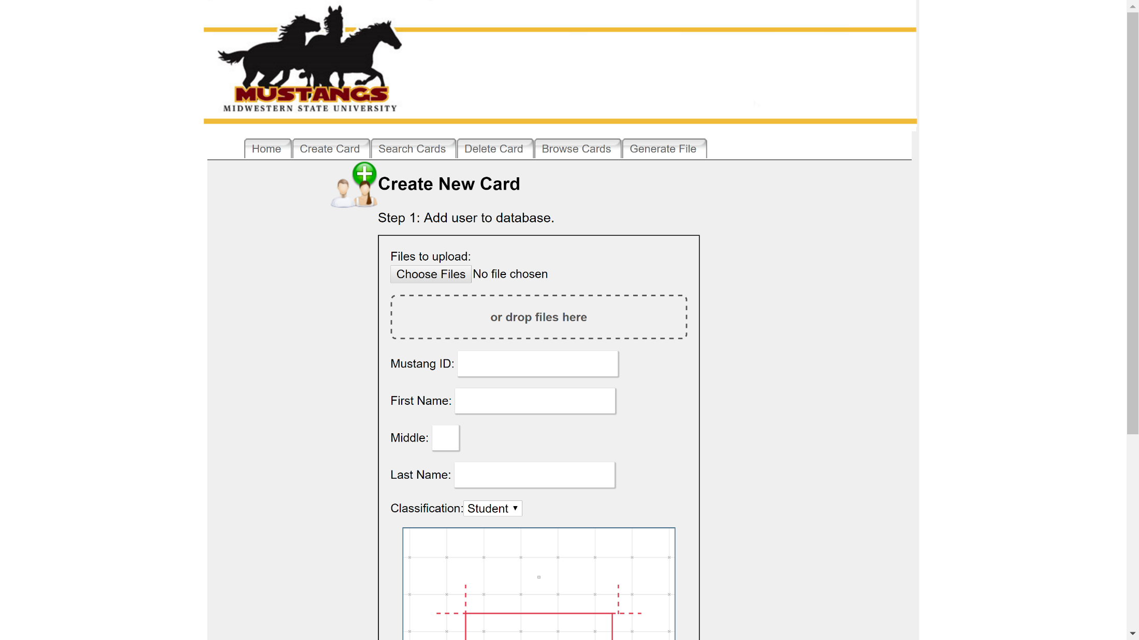
Previous Create Card Page

Slide 13
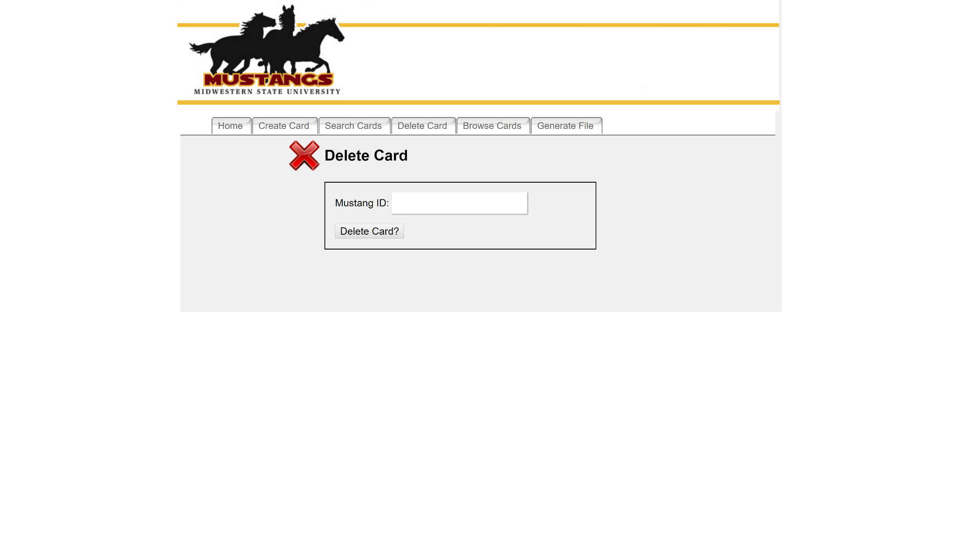
Previous Delete Cards Page

Slide 14
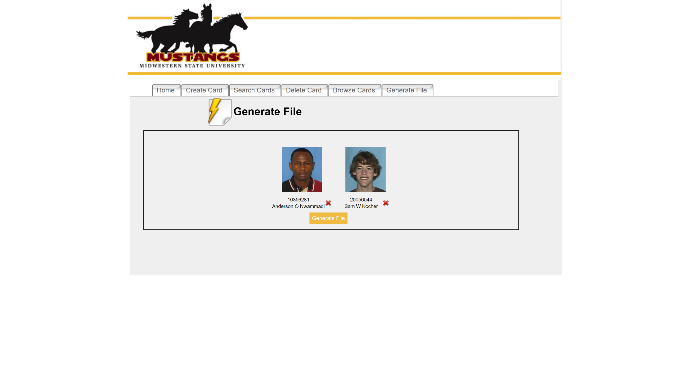
Previous Generate File Page

Slide 15
Demonstration of New Interface
Provided by: Tellon Smith

